Slide 1
AVL trees
(Adelson – Velskii – Landis)

Slide 2
Balanced Binary Search Tree
Worst case height of binary search tree: N-1
  Insertion, deletion can be O(N) in the worst case
We want a tree with small height
Height of a binary tree with N node is at least O(log N)
  Complete binary tree has height log N.
Goal: keep the height of a binary search tree O(log N)
Balanced binary search trees
  Examples: AVL tree, red-black tree

Slide 3
AVL tree
for each node, the height of the left and right subtrees can differ by at most d = 1.
Maintaining a stricter condition (e.g above condition with d = 0) is difficult.
Note that our goal is to perform all the operations search, insert and delete in O(log N) time, including the operations involved in adjusting the tree to maintain the above balance condition.

Slide 4
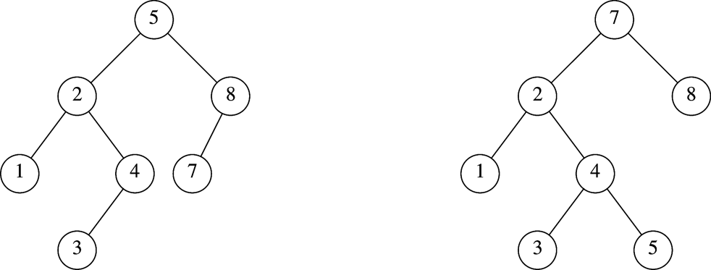
AVL Tree
An AVL tree is a binary search tree in which
  for every node in the tree, the height of the left and right subtrees differ by at most 1.
Height of subtree: Max # of edges to a leaf
Height of an empty subtree: -1
  Height of one node: 0
AVL tree property violated here
AVL tree

Slide 5
AVL Tree with Minimum Number of Nodes
N₁ = 2
N₂ =4
N₃ = N₁+N₂+1=7
N₀ = 1

Slide 6
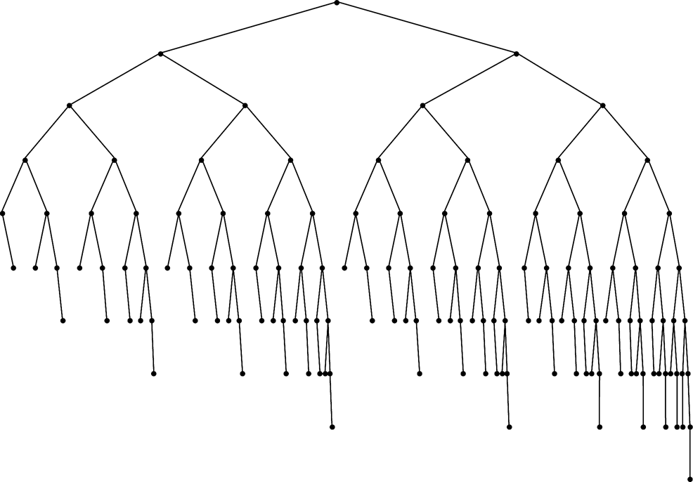
Smallest AVL tree
of height 7
Smallest AVL tree
of height 8
Smallest AVL tree of height 9

Slide 7
AVL Tree Representation
struct AVLTree
{
int data;
struct AVLTree *left;
struct AVLTree *right;
int height;
};

Slide 8
Finding the Height of an AVL
int Height (struct AVLTree *root)
{
if (!root)
return -1;
else
return root->height;
};

Slide 9
Insertion in AVL Tree
Basically follows insertion strategy of binary search tree
  But may cause violation of AVL tree property.
Restore the destroyed balance condition if needed

Slide 10
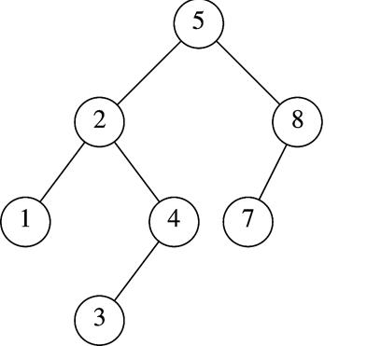
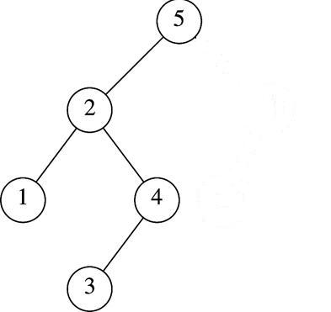
Insertion in AVL Tree
Basically follows insertion strategy of binary search tree
  But may cause violation of AVL tree property
Restore the destroyed balance condition if needed
7
6
8
6
Insert 6
Property violated
Original AVL tree
Restore AVL property

Slide 11
Some Observations
After an insertion (using the insertion algorithm for a binary search tree), only nodes that are on the path from the insertion point to the root might have their balance altered.
  Because only those nodes have their subtrees altered
So it’s enough to adjust the balance on these nodes.
We will see that AVL tree property can be restored by performing rotation at a single node.

Slide 12
Node at which balancing must be done
The node of smallest depth on the path from to the newly inserted node.
We will call this node pivot.
Example:
Suppose we inserted key is 2.5
Pivot is the node containing 4.
This is the lowest depth node in the path where the AVL tree property is violated.
*
2.5

Slide 13
Rotations
We perform rotation in AVL tree only in case if Balance Factor is other than -1, 0, and 1. There are basically four types of rotations which are as follows:
  L L rotation: Inserted node is in the left subtree of left subtree of C
  R R rotation : Inserted node is in the right subtree of right subtree of C
  L R rotation : Inserted node is in the right subtree of left subtree of C
  R L rotation : Inserted node is in the left subtree of right subtree of C
Where node C is the node whose balance Factor is other than -1, 0, 1.

Slide 14
Rotations
Single Rotations
Left Left Rotation (LL Rotation):
In the case below, node C is not satisfying the AVL tree property. As discussed earlier, the rotation does not have to be done at the root of a tree. In general, we start at the node inserted and travel up the tree, updating the balance information at every node on the path.
C
single rotation
B
B
A
C
A
T
3
T
0
T
0
T
2
T
T
T
1
2
3
T
1

Slide 15
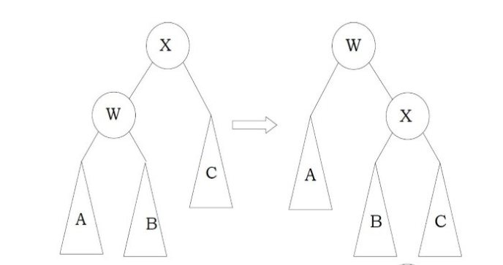
LL-Rotations (Single Left)
int Height (struct AVLTree *root)
{
if (!root)
return -1;
else
return root->height; };
struct AVLTree
{
int data;
struct AVLTree *left;
struct AVLTree *right;
int height;
};
}

Slide 16
LL-Rotations
struct AVLTree *SingleLeft(struct AVLTree *X)
{
struct AVLTree *W = X->left;
X->left = W->right;
W->right = X;
X->height = max( Height(X->left), Height(X->left))+1;
W->height= max( Height(W->left), X->height )+1;
return W; /*new root*/

Slide 17
Right Right Rotation (Single Right)
Single Rotations
Right Right Rotation (RR Rotation):
In the case below, node A is not satisfying the AVL tree.
A
single rotation
B
B
A
C
C
T
0
T
3
T
1
T
T
T
T
3
0
1
2
T
2

Slide 18
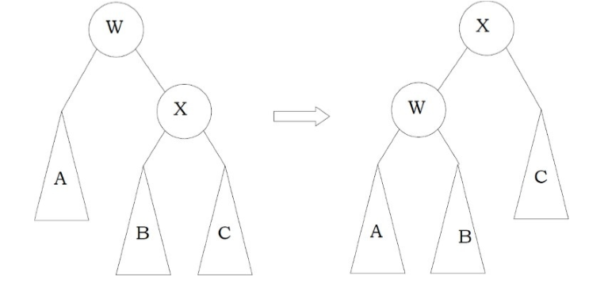
struct AVLTree
{
int data;
struct AVLTree *left;
struct AVLTree *right;
int height;
};
int Height (struct AVLTree *root)
{
if (!root)
return -1;
else
return root->height; };

Slide 19
struct AVLTree *SingleRight(struct AVLTree *W)
{
struct AVLTree *X = W->right;
W->right =X->left ;
X->left = W;
W->height = max( Height(W->left), Height(W->left))+1;
X->height= max( Height(X->right), W->height )+1;
return X; /*new root*/
}

Slide 20
Left-Right Rotation (Double)
C
double rotation
B
A
A
C
B
T
T
0
2
T
T
T
T
T
3
2
3
1
0
T
1

Slide 21
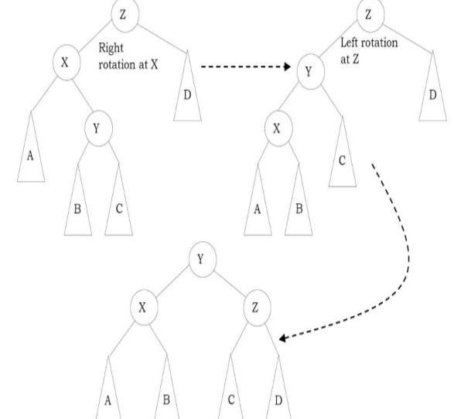

Slide 22
struct AVLTree *Left-Right(struct AVLTree *Z)
{
Z->left= SingleRight(Z->left);
return SingleLeft(Z );
}

Slide 23
Right-Left Rotation (Double )
A
double rotation
B
C
A
C
B
T
T
0
2
T
T
T
T
T
2
3
0
1
3
T
1

Slide 24
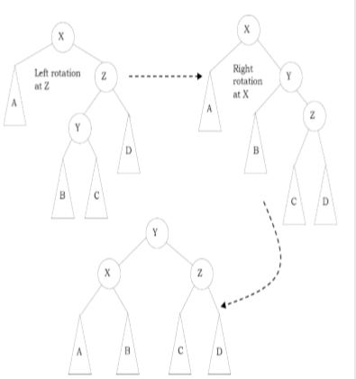

Slide 25

struct AVLTree *Right-Left (struct AVLTree *X)
{
X->right= SingleLeft(X->right);
return SingleRight(X );
}

Slide 26
Insertion Algorithm (outline)
First, insert the new key as a new leaf just as in ordinary binary search tree
Then trace the path from the new leaf towards the root. For each node x encountered, check if heights of left(x) and right(x) differ by at most 1.
  If yes, proceed to parent(x)
  If not, restructure by doing either a single rotation or a double rotation
Note: once we perform a rotation at a node x, we won’t need to perform any rotation at any ancestor of x.

Slide 27
Summary
AVL trees with n nodes will have height at most 1.5 log₂ n
To implement AVL tree, we use an extra field at each node that stores the height of the subtree rooted at the node.
To insert a key, at most a constant number of pointer changes need to be performed. This is done by a single rotation or a double rotation at the pivot node.
All dictionary operations can be performed in O(log n) time in the WORST-CASE using AVL trees.

Slide 28
AVL Tree Rotations
Single rotations:
Inserting 16 causes AVL violation:
14
15
16
Need to rotate.

Slide 29
AVL Tree Rotations
Single rotations:
Inserting 16 causes AVL violation:
14
15
16
Need to rotate.

Slide 30
AVL Tree Rotations
Single rotations:
Rotation type:
14
15
16

Slide 31
AVL Tree Rotations
Single rotations:
Rotation restores AVL balance:
15
14
16

Slide 32
AVL Tree Rotations
Single rotations:
Now insert 13 and 12:
15
14
16
13
12
AVL violation - need to rotate.

Slide 33
AVL Tree Rotations
Single rotations:
Rotation type:
15
14
16
13
12

Slide 34
AVL Tree Rotations
Single rotations:
15
13
16
12
14
Now insert 11.

Slide 35
AVL Tree Rotations
Single rotations:
15
13
16
12
14
11
AVL violation – need to rotate

Slide 36
AVL Tree Rotations
Single rotations:
Rotation type:
15
13
16
12
14
11

Slide 37
AVL Tree Rotations
Single rotations:
13
12
15
14
16
11
Now insert 10.

Slide 38
AVL Tree Rotations
Single rotations:
13
12
15
14
16
11
10
AVL violation – need to rotate

Slide 39
AVL Tree Rotations
Single rotations:
Rotation type:
13
12
15
14
16
11
10

Slide 40
AVL Tree Rotations
Single rotations:
13
11
15
10
12
14
16
AVL balance restored.

Slide 41
AVL Tree Rotations
Double rotations: insert 1, 2, 3, 4, 5, 7, 6, 9, 8
First insert 1 and 2:
13
11
15
10
12
14
16

Slide 42
AVL Tree Rotations
Double rotations:
AVL violation - rotate
13
11
15
14
16
10
12
1
2

Slide 43
AVL Tree Rotations
Double rotations:
Rotation type:
13
11
15
14
16
10
12
1
2

Slide 44
AVL Tree Rotations
Double rotations:
AVL balance restored:
13
11
15
2
12
14
16
1
10
Now insert 3.

Slide 45
AVL Tree Rotations
Double rotations:
AVL violation – rotate:
13
11
15
2
12
14
16
1
10
3

Slide 46
AVL Tree Rotations
Double rotations:
Rotation type:
13
11
15
2
12
14
16
1
10
3

Slide 47
AVL Tree Rotations
AVL balance restored:
Double rotations:
13
10
15
2
11
14
16
1
3
12
Now insert 4.

Slide 48
AVL Tree Rotations
Double rotations:
AVL violation - rotate
13
10
15
2
11
14
16
1
3
12
4

Slide 49
AVL Tree Rotations
Single rotations:
Rotation type:
13
10
15
2
11
14
16
1
3
12
4

Slide 50
AVL Tree Rotations
Double rotations:
10
2
13
1
3
11
15
4
12
14
16
Now insert 5.

Slide 51
AVL Tree Rotations
Double rotations:
10
2
13
1
3
11
15
4
12
14
16
5
AVL violation – rotate.

Slide 52
AVL Tree Rotations
Single rotations:
Rotation type:
10
2
13
1
3
11
15
4
12
14
16
5

Slide 53
AVL Tree Rotations
Single rotations:
AVL balance restored:
10
2
13
1
4
11
15
3
5
12
14
16
Now insert 7.

Slide 54
AVL Tree Rotations
Single rotations:
AVL violation – rotate.
10
2
13
1
4
11
15
3
5
12
14
16
7

Slide 55
AVL Tree Rotations
Single rotations:
Rotation type:
10
2
13
1
4
11
15
3
5
12
14
16
7

Slide 56
AVL Tree Rotations
Double rotations:
AVL balance restored.
10
4
13
2
5
11
15
7
12
14
16
1
3
Now insert 6.

Slide 57
AVL Tree Rotations
Double rotations:
AVL violation - rotate.
10
4
13
2
5
11
15
7
12
14
16
1
3
6

Slide 58
AVL Tree Rotations
Double rotations:
Rotation type:
10
4
13
2
5
11
15
7
12
14
16
1
3
6

Slide 59
AVL Tree Rotations
Double rotations:
AVL balance restored.
10
4
13
2
6
11
15
12
14
16
1
3
5
7
Now insert 9 and 8.

Slide 60
AVL Tree Rotations
Double rotations:
AVL violation - rotate.
10
4
13
2
6
11
15
12
14
16
1
3
5
7
9
8

Slide 61
AVL Tree Rotations
Double rotations:
Rotation type:
10
4
13
2
6
11
15
12
14
16
1
3
5
7
9
8

Slide 62
AVL Tree Rotations
Final tree:
Tree is almost perfectly balanced
10
4
13
2
6
11
15
12
14
16
1
3
5
8
7
9

Slide 63
Insert Algorithm
struct AVLTree*Insert( struct AVLTree *root, struct AVLTree *parent,int data){
if(!root)
{
root= (struct AVLTree *)malloc(sigeof(struct AVLTree *));
root->data=data; root->height=0; root->left=root->right=Null;
}
else if (data < root->data)
{
root->left=Insert( root->left, root, data);
if(Height(root->left- Height(root->right))==2)
{ if(data<root->left)
root=SingleLeft(root);
else root=Left-Right(root);
}
}

Slide 64
else if (data > root->data)
{
root->right=Insert( root->right, root, data);
if(Height(root->right- Height(root->left))==2)
{ if(data<root->left)
root=SingleRight(root);
else root=Right-Left(root);
}
}
/* Else Data is already in Tree we do nothing */
root->height=max(Height(root->left), Height(root->right))+1;
return root;

Slide 65
Deletion in AVL Tree

Slide 66
Deletion Operation In AVL
The deletion operation in the AVL tree is the same as the deletion operation in BST.
In the AVL tree, the node is always deleted as a leaf node and after the deletion of the node, the balance factor of each node is modified accordingly.
Rotation operations are used to modify the balance factor of each node.

Slide 67
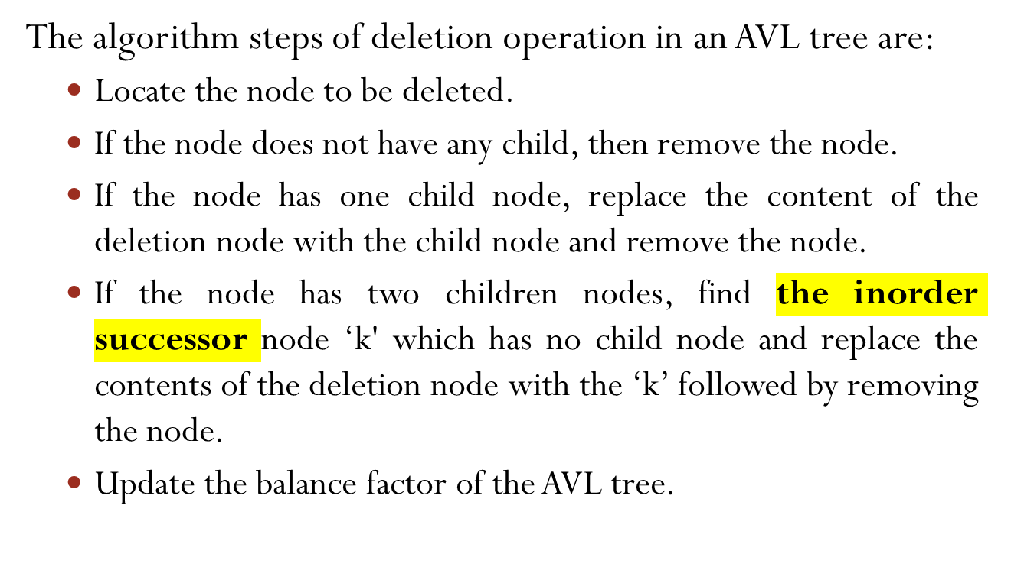
Deletion Operation In AVL

Slide 68
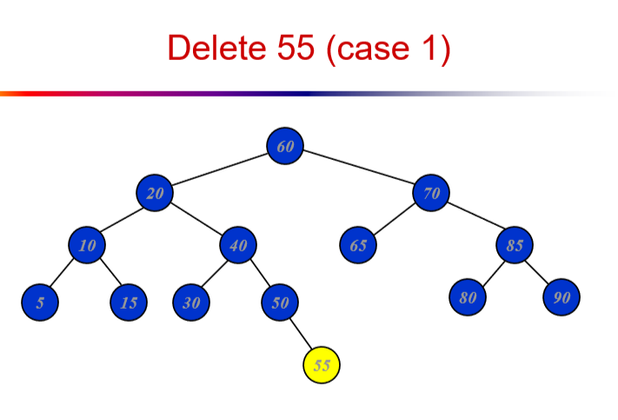

Slide 69
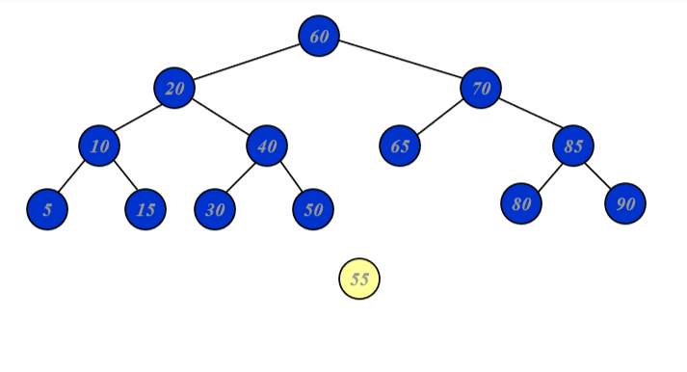

Slide 70
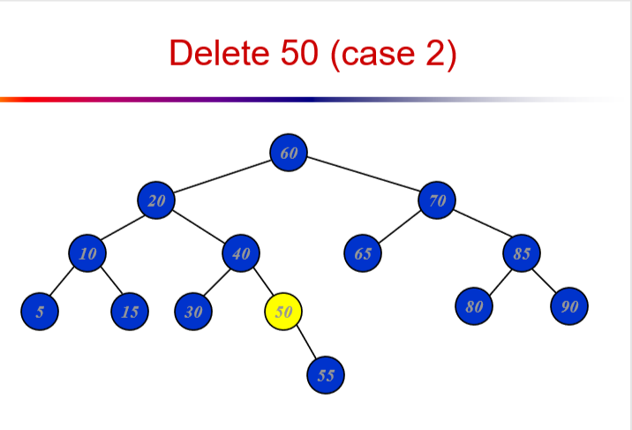

Slide 71
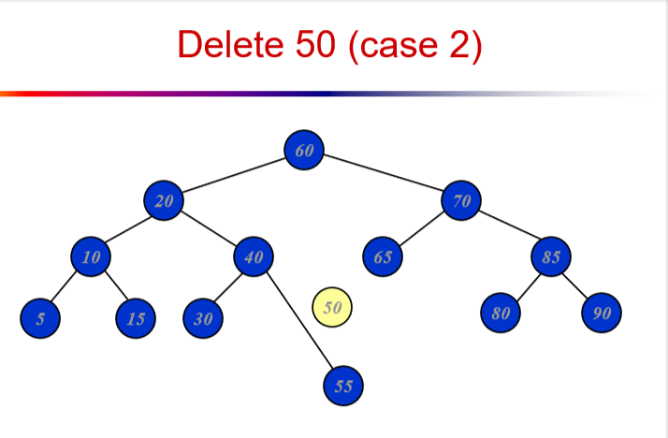

Slide 72
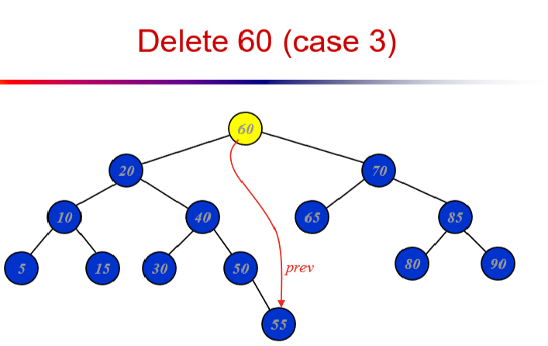

Slide 73
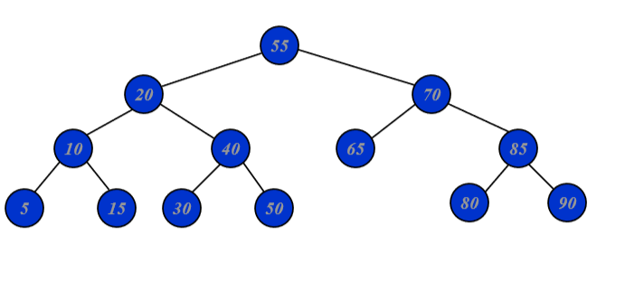

Slide 74
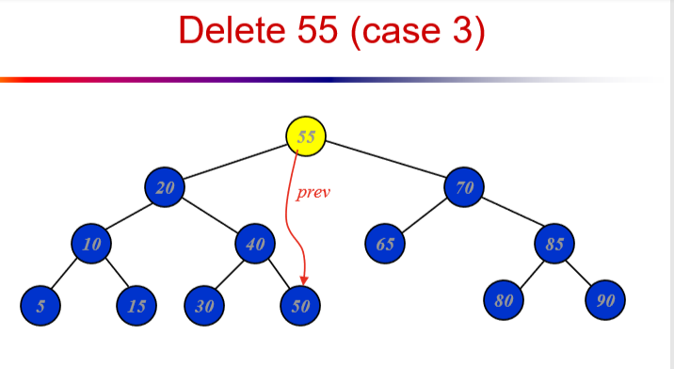

Slide 75
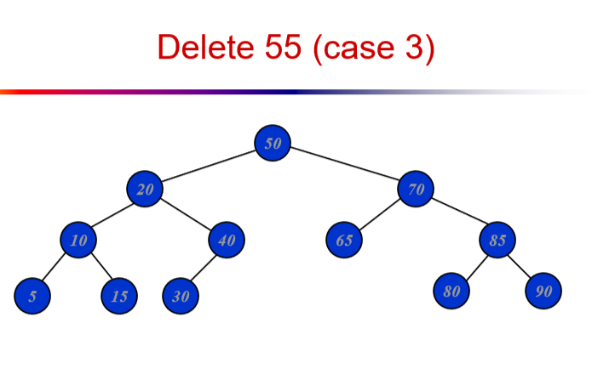

Slide 76
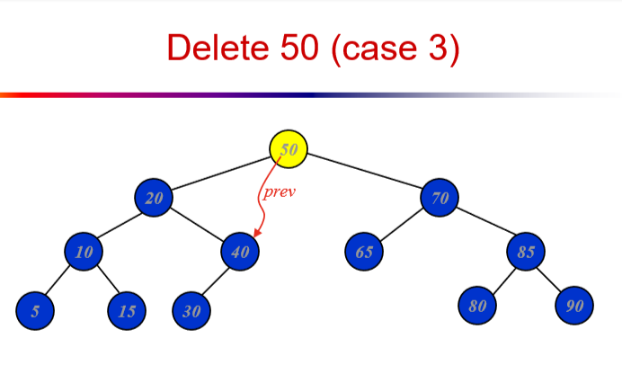

Slide 77
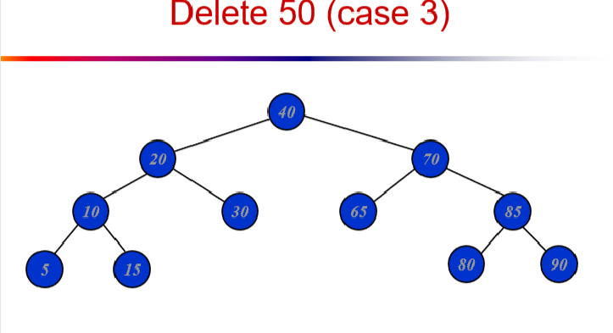

Slide 78
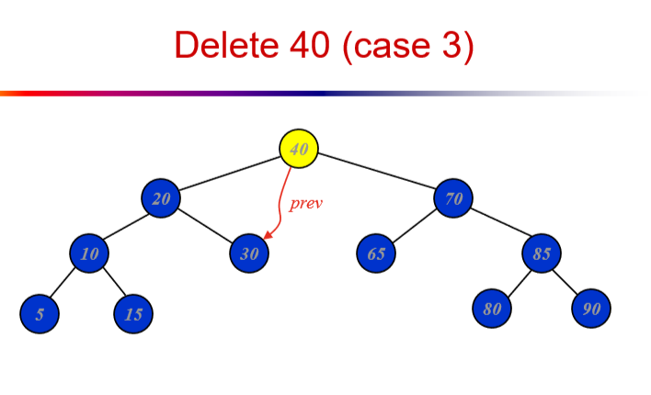

Slide 79
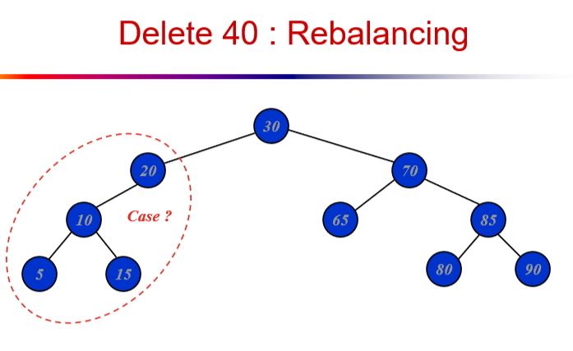

Slide 80
